Slide 1

BYD Analysis
Juan Camilo Castillo

Slide 2

Intro
What is BYD?
Build Your Dreams is a chinese company specialized in producing Electric Vehicles, Rail transport, batteries and electronics.
What’s their goal?
Innovate in the exploitation of clean energies, reducing world’s reliance on fossil fuels.
When was it founded?
Founded in 1995 by Wang Chuanfu in Shenzhen, China.

Slide 3
Intro
What is the size of BYD in terms of employees?
By the end of 2023, the company had around 703,500 employees and presence on over 70 countries.
What is the size of the company?
BYD is placed among the 20 biggest companies in China in terms of intraday market capitalization (142,40B ).
What is its relevance in the global EV market?
For 2024, it had a share of 16% of the BEV global market, just surpassed by Tesla.

Slide 4
SWOT
S
Strong technological capabilities, they produce the batteries and the vehicles.
Wide portfolio of electric vehicles and strong presence in public transportation
Price advantage
W
Consumer’s perception
Less established that other brands
Strong reliance on Chinese market
O
Chinese government support to renewable energies.
Dynamic demand for electric vehicles globally.
T
Established brands adapting to electric vehicles
Technological advancements of competition
Tariffs increase applied to Chinese exports

Slide 5
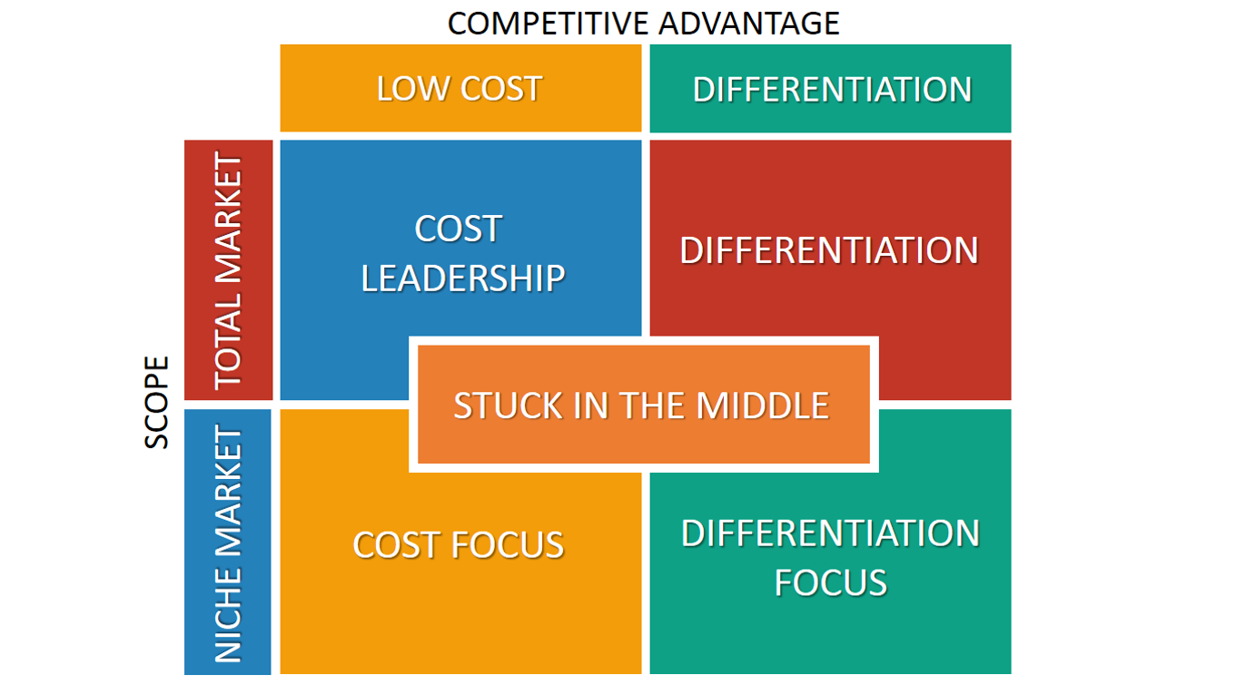


Position of BYD

Slide 6
Income Statement
CNY | 2020 | 2021 | 2022 | 2023 | 2024
Total Revenue | 156,597 M | 216,142 M | 424,060 M | 602,315 M | 682,291 M
Total Expenses | 143,552 M | 208,545 M | 401,084 M | 563,902 M | 636,003 M
Net Income | 4,234 M | 3,045 M | 16,622 M | 30,040 M | 33,912 M
Growth Net Income |  | -28.08% | 445.87% | 80.72% | 12.88 %

Slide 7
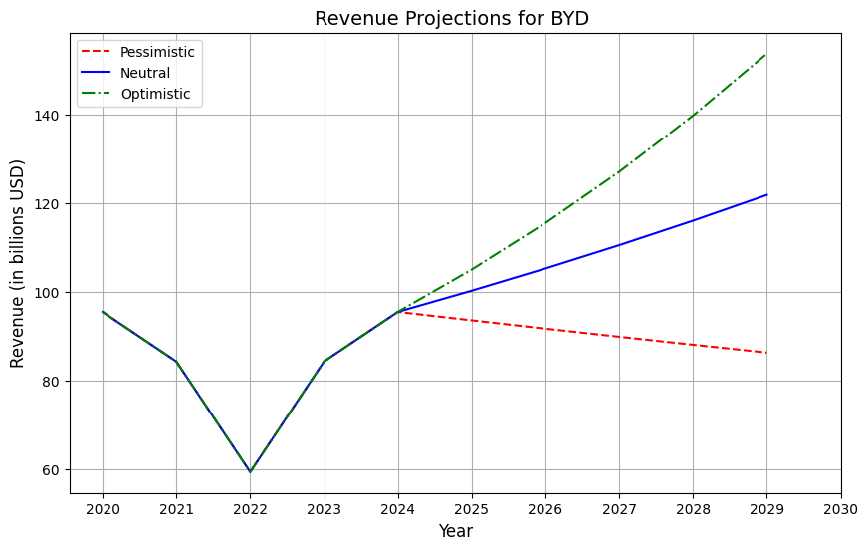
Revenue Projections

Slide 8
Opportunities & Risk
Dynamic demand for electric vehicles globally
In 2024, the EV market grew in a 25% in comparison to 2023 (USD 500.48 billion in 2023), showing an increasing demand that companies like BYD could benefit from specially in the chinese and european market. The support of the chinese government via subsidies also represents an opportunity for the firm to expand even more its scope.
Technological advancements of competition
The EV’s production can be technology intensive, with constant improvements in the products’ capabilities, the competition of brands such as Tesla, widely known as innovative, or Geely, can represent a threat for BYD’s market share worldwide.

Slide 9
Opportunity: Improving self-driving technologies
One of the main difficulties that BYD faces is that public opinion favors Tesla’s innovation and luxury. A key project that can improve this situation is improving BYD’s automobiles self-driving capacity.
This would improve the company’s perception in terms of innovation and the features customers would expect from the brand products.

Slide 10
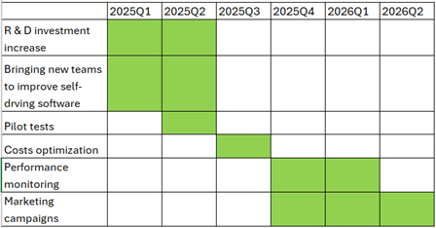
Opportunity: Improving self-driving technologies

